Slide 1


Introduction to Database Systems
Lecture – 2

Slide 2
Database Architecture
Reading Assignment:
Chapter 2: Database Environment

Slide 3
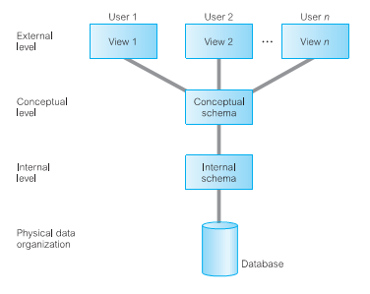
Three-Level ANSI-SPARC Architecture American National Standards Institute (ANSI) Standards Planning and Requirements Committee (SPARC)
Architecture : Refers to permanent structure
or intention of database
Represented by three schemas or three models

Slide 4
Three-level Architecture
The way users perceive the data is called the external level.
The way the DBMS and the operating system perceive the data is the internal level, where the data is actually stored using the data structures and file organizations.
The conceptual level provides both the mapping and the desired independence between the external and internal levels.

Slide 5
Why????
The objective of the three-level architecture is to separate each user’s view of the database from the way the database is physically represented:
Each user should be able to access the same data, but have a different customized view of the data. Each user should be able to change the way he or she views the data, and this change should not affect other users.
Users should not have to deal directly with physical database storage details, such as indexing or hashing. In other words, a user’s interaction with the database should be independent of storage considerations.
The Database Administrator (DBA) should be able to change the database storage structures without affecting the users’ views.
The internal structure of the database should be unaffected by changes to the physical aspects of storage, such as the changeover to a new storage device.
The DBA should be able to change the conceptual structure of the database without affecting all users.

Slide 6
External View
The users’ view of the database. This level describes that part of the database that is relevant to each user.
Different views may have different representations of the same data. For example, one user may view dates in the form (day, month, year), while another may view dates as (year, month, day).
External schema evolves as user needs are modified over time.

Slide 7
Conceptual Level
The community view of the database. This level describes what data is stored in the database and the relationships among the data.
This level contains the logical structure of the entire database as seen by the DBA.
All entities, their attributes, and their relationships
Constraints on the data;
Semantic information about the data;
Security and integrity information.
No storage considerations, such as the number of bytes occupied.
Notes:
The conceptual level supports each external view, in that any data available to a user must be contained in, or derivable from, the conceptual level. However, this level must not contain any storage-dependent details. For instance, the description of an entity should contain only data types of attributes (for example, inte ger, real, character) and their length (such as the maximum number of digits or characters), but not any storage considerations, such as the number of bytes occupied.

Slide 8
Internal Level OR Physical Level
The physical representation of the database on the computer. This level describes how the data is stored in the database.
storage space allocation for data and indexes;
record descriptions for storage (with stored sizes for data items);
data compression and data encryption techniques.
Below the internal level there is a physical level that may be managed by the operating system under the direction of the DBMS.

Slide 9
Three-level Architecture
First Name: Rana Last Name: Aslam Date of Birth: 12 Sep, 1970
Name: R. Aslam Age: 24y, 10d Dept: Sales
Name | DoB | Deps | DepId
Rana Aslam | 12/09/70 | 5 | D001
Marya Wasti | 29/02/80 | 0 | D005
BH RH Rana Aslam 120970 5 D001 RH Marya Wasti
01110011010011100101001010100101

Slide 10
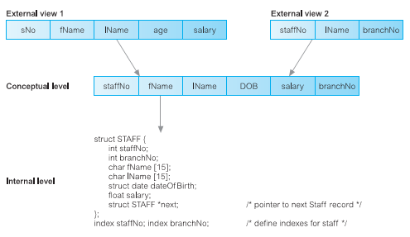
Difference between Three-levels

Slide 11
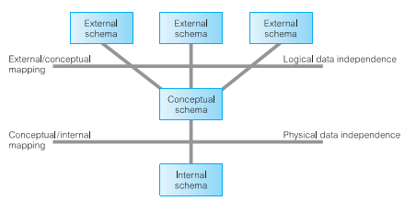
Data Independent

Slide 12
Data Independent
Logical data independence: Logical data independence refers to the immunity of the external schemas to changes in the conceptual schema.
Physical data independence: Physical data independence refers to the immunity of the conceptual schema to changes in the internal schema.

Slide 13
Data Model
A model is a representation of ‘real world’ objects and events, and their associations.
Data model is integrated collection of concepts for describing and manipulating data, model relationships between data, and constraints on the data in an organization.
A structural part, consisting of a set of rules according to which databases can be constructed
A manipulative part, defining the types of operation that are allowed on the data (this includes the operations that are used for updating or retrieving data from the database and for changing the structure of the database)
Possibly a set of integrity constraints, which ensures that the data is accurate

Slide 14
Data Model
There have been many data models proposed in the literature. They fall into three broad categories:
object-based
record-based,
and physical data models.
The first two are used to describe data at the conceptual and external levels, the latter is used to describe data at the internal level.

Slide 15
Object Based Data Models
Object-based data models use concepts such as entities, attributes, and relationships.
An entity is a distinct object (a person, place, thing, concept, event) in the organization that is to be represented in the database.
An attribute is a property that describes some aspect of the object that we wish to record,
and a relationship is an association between entities.
Entity–Relationship
Object-Oriented.

Slide 16
Record Based Data Models
In a record-based model, the database consists of a number of fixed-format records possibly of differing types.
Each record type defines a fixed number of fields, each typically of a fixed length.
There are three principal types of record-based logical data model
Relational data model
Network data model
and the hierarchical data model.

Slide 17
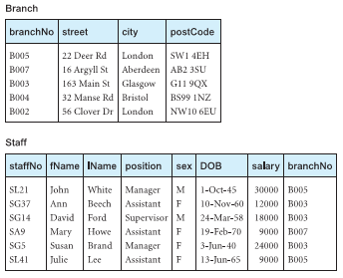
Relational data model

Slide 18
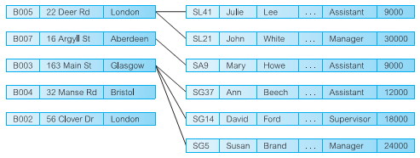
Network data model

Slide 19
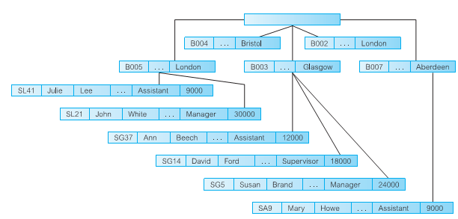
Hierarchal Data model

Slide 20
Multi-User DBMS Architectures
Reading Assignment:
Chapter 3: Database Architectures
and the Web

Slide 21
Multi-User DBMS Architectures
Teleprocessing
File-server
Client–server

Slide 22
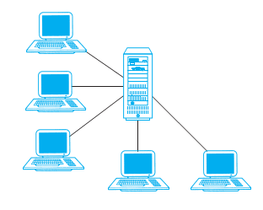
Teleprocessing
There is one computer with a single central processing unit (CPU) and a number of terminals.

Slide 23
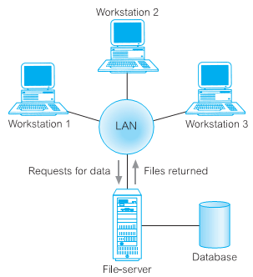
File-Server Architecture
There is a large amount of network traffic.
A full copy of the DBMS is required on each workstation.
Concurrency, recovery, and integrity control are more complex because there can be multiple DBMSs accessing the same files.

Slide 24
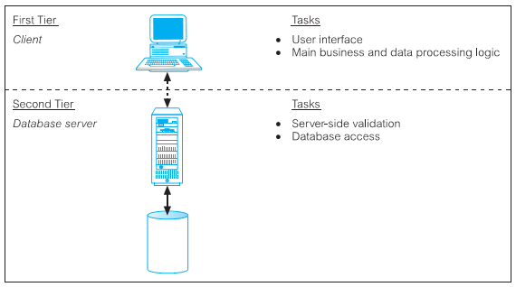
Two – Tier Client Server Architecture

Slide 25
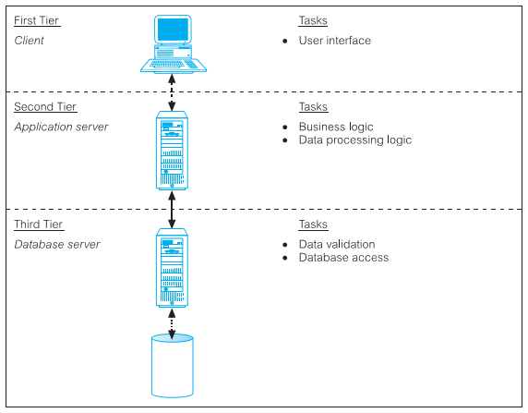
Three – Tier Client Server Architecture

Slide 26
Thank You

